Slide 1
Composite
Tomás Santos - 112981
April 24th, 2024

Slide 2
When should we use this pattern?
1. When we have to implement a tree-like object structure
The Composite pattern provides two basic element types that share a common interface: simple leaves and complex containers. A container can be composed of both leaves and other containers. This lets us construct a nested recursive object structure that resembles a tree.
2. When we want the client code to treat both simple and complex elements uniformly.
All elements defined by the Composite pattern share a common interface. Using this interface, the client doesn’t have to worry about the concrete class of the objects it works with.

Slide 3
How to implement this pattern?
We have to make sure that the core model of the app can be represented as a tree structure.
- Try to break it down into simple elements and containers
- Containers must be able to contain both simple elements and other containers
2. Declare the component interface with a list of methods that make sense for both simple and complex components.
3. Create a leaf class to represent simple elements. A program may have multiple different leaf classes.
4. Create a container class to represent complex elements:
- Provide an array field for storing references to sub-elements.
This container is supposed to be delegating most of the work to sub-elements!
5. Finally, we have to define the methods for adding and removal of child elements in the container.
3

Slide 4
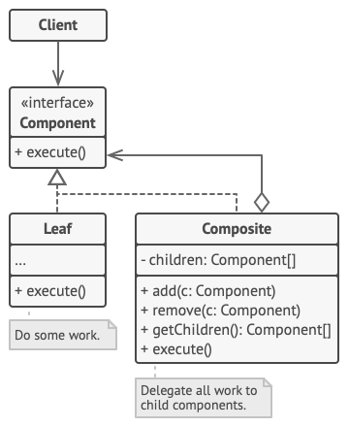
(Base) Class Structure

Slide 5

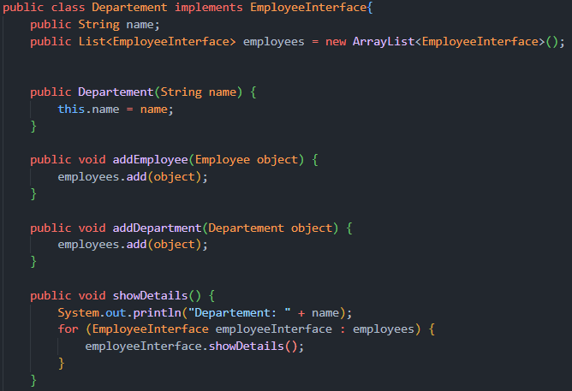
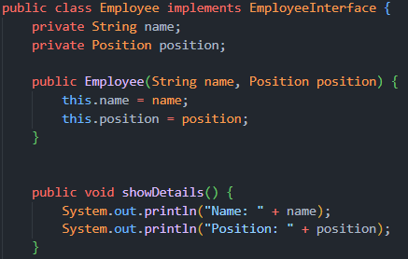



Code Example(s)

